Slide 1

SUPERSTORE Sales dashboard & forecasting
Data analysis in power bi

Slide 2


Slide 3
objectives
To contribute to the success of a business by utilizing data analysis techniques, specially focusing on time series analysis, to provide valuable insights and accurate sales forecasting, and interactive dashboard creation, driving business success.

Slide 4
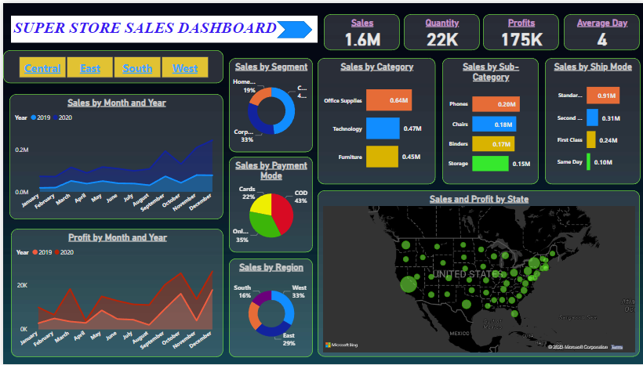

Slide 5
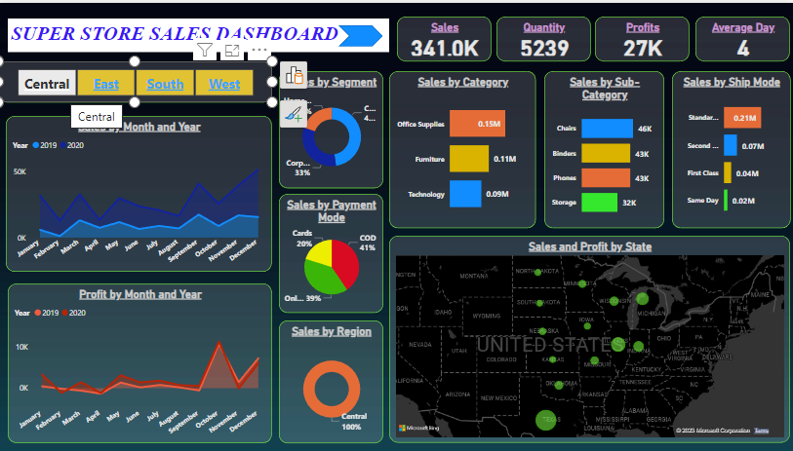

Slide 6
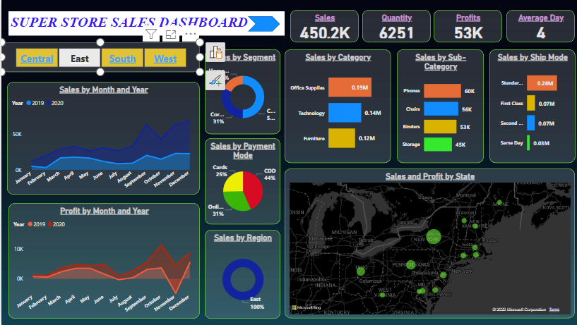

Slide 7
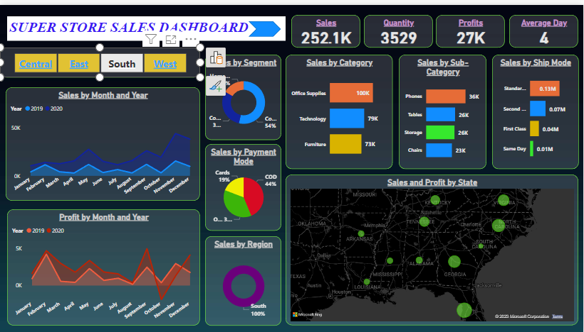

Slide 8
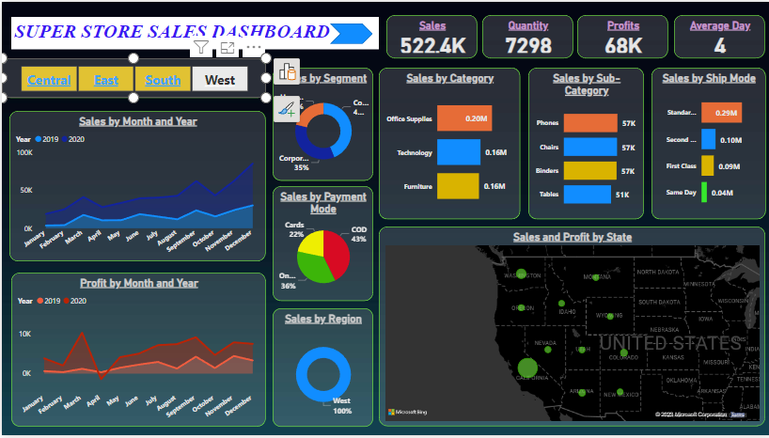

Slide 9
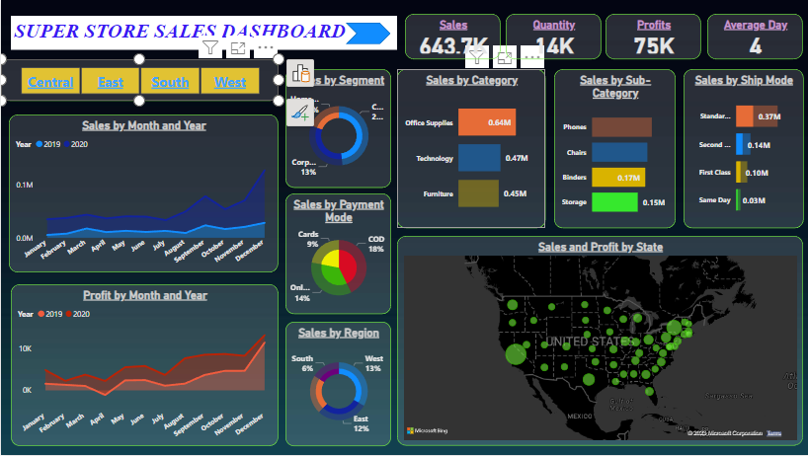

Slide 10
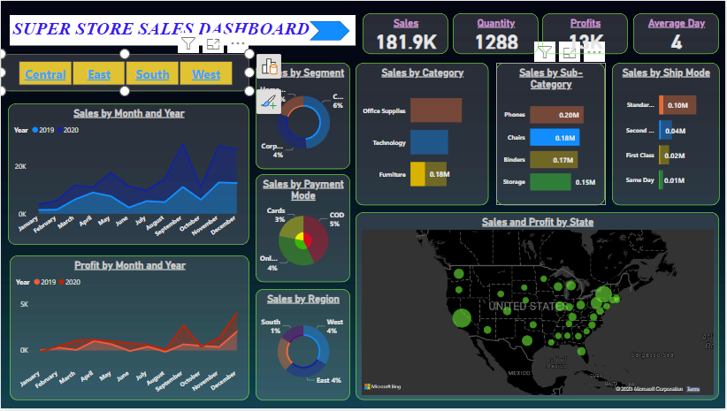

Slide 11
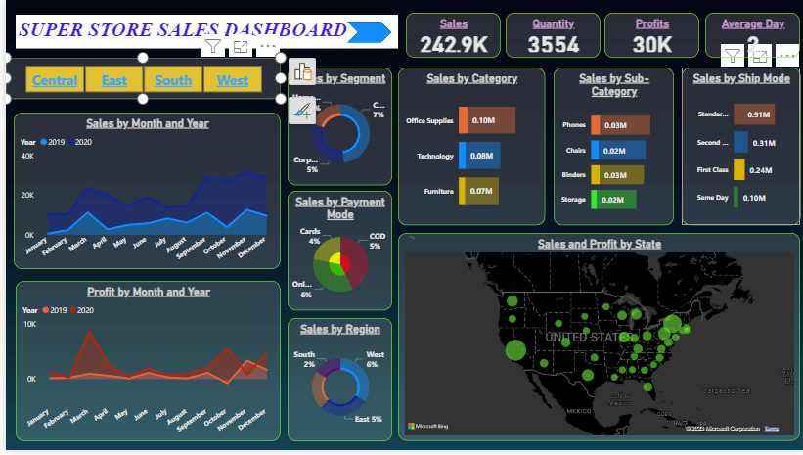

Slide 12
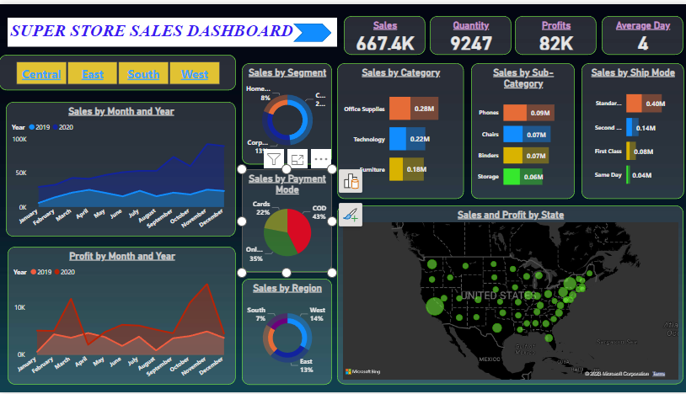

Slide 13
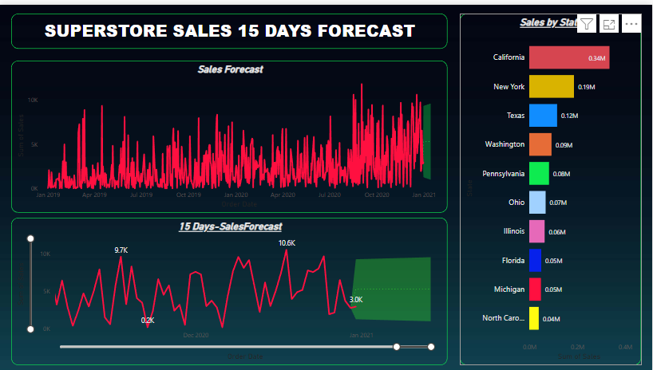

Slide 14
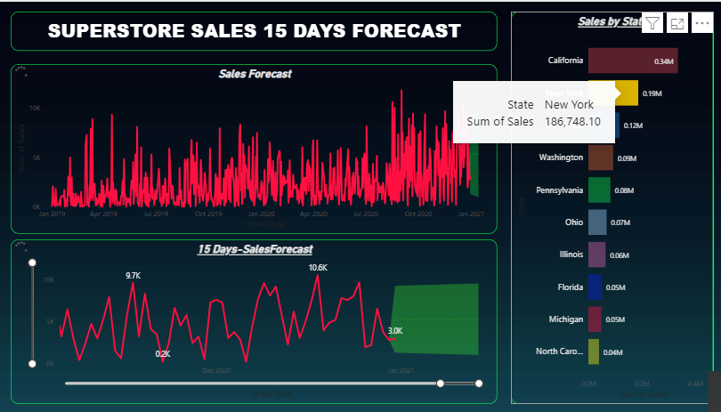

Slide 15
